Slide 1

COMPUTATIONAL ANALYSIS OF VARIOUS THERMAL BARRIER COATINGS ON STEEL SURFACE
UNDER THE ESTEEMED GUIDANCE OF
( HOD )
DR. M. RAMALINGA REDDY
(Director)
DR. S. NAGA KALYAN
(Professor)
SUBMITTED BY
PARVATHAM SIVA MALLIKARJUN 18WJ1A03F3
DEPARTMENT OF MECHANICAL ENGINEERING
GURU NANAK INSTITUTIONS TECHNICAL CAMPUS (AUTONOMOUS)
(AUTONOMOUS)

Slide 2
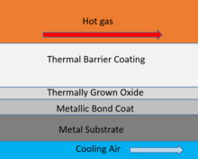
COMPUTATIONAL ANALYSIS OF VARIOUS THERMAL BARRIER COATINGS ON STEEL SURFACE
AIM OF THE PROJECT
To determine the better thermal barrier coatings on steel surface

Slide 3
COMPUTATIONAL ANALYSIS OF VARIOUS THERMAL BARRIER COATINGS ON STEEL SURFACE
Main Objective is to choose the better variant TBC among the other TBC’S which is computed.
The better variant TBC will be more in heat dissipation.
The TBC are applied for need to tinny surfaces operational at elevated temperatures, as a variety of exhaust heat management.
We use Steel AISL4340 as the metal substrate in TBCs coatings.

Slide 4
COMPUTATIONAL ANALYSIS OF VARIOUS THERMAL BARRIER COATINGS ON STEEL SURFACE
Thermal barrier coatings (TBCs) area unit advanced materials systems typically applied to tinny surfaces operational at elevated temperatures, as a variety of exhaust heat management.
The heat barrier coatings resist the thermal conduction by adding composite materials and increasing the heat barrier temperature in numerous fields like a turbine or aero-engine components, area crafts, rocket –jet engines, jet propellers etc.
The heat barrier systems use numerous ceramic constituents to form a barrier to the temperatures tough operational.
They are doing not type a barrier to hot corrosion and chemical reaction merchandise however do act as an insulation layer reducing the results of thermal conduction.

Slide 5
COMPUTATIONAL ANALYSIS OF VARIOUS THERMAL BARRIER COATINGS ON STEEL SURFACE
In these TBC’s the materials area unit applied like composites of Amorphous Al₂O₃, Amorphous MoO₃, Amorphous TiO₂, Pure ZrO₂,7-8YSZ and a few compositions severally were doped with Yttria-stabilized Zirconia (YSZ) to create a TBC layer on the steel surface. That were computed severally.
According to the Finite component Analysis, the composition of Pure ZrO₂ doped with YSZ TBC have higher performance within the temperature of heat barrier compare to different TBC’s severally.

Slide 6
COMPUTATIONAL ANALYSIS OF VARIOUS THERMAL BARRIER COATINGS ON STEEL SURFACE
The composite we analyzed are
A Composite Thermal barrier of Amorphous Al2O3 doped with Yttria stabilized zirconia (YSZ)
A Composite Thermal barrier of Amorphous MoO3 doped with Yttria stabilized zirconia (YSZ)
A Composite Thermal barrier of Amorphous TiO2 doped with Yttria stabilized zirconia (YSZ)
A Composite Thermal barrier of Pure ZrO2 doped with Yttria stabilized zirconia (YSZ)
A Composite Thermal barrier of ZrO2 doped with Yttria stabilized zirconia (YSZ)

Slide 7
COMPUTATIONAL ANALYSIS OF VARIOUS THERMAL BARRIER COATINGS ON STEEL SURFACE
A Composite Thermal barrier of 7-8YSZ doped with Yttria stabilized zirconia (YSZ)
A Composite Thermal barrier of 80%ZrO2+10%Y2O3+10%MoO3 doped with Yttria stabilized zirconia (YSZ)
A Composite Thermal barrier of 90%ZrO2+5%Y2O3+5%MoO3 doped with Yttria stabilized zirconia (YSZ)
A Composite Thermal barrier of 80%ZrO2+10%Y2O3+10%Al2O3 doped with Yttria stabilized zirconia (YSZ)
A Composite Thermal barrier of 90%ZrO2+5%Y2O3+5%Al2O3 doped with Yttria stabilized zirconia (YSZ)
A Composite Thermal barrier of 80%ZrO2+10%Y2O3+10%TiO2 doped with Yttria stabilized zirconia (YSZ)
A Composite Thermal barrier of 90%ZrO2+5%Y2O3+5%TiO2 doped with Yttria stabilized zirconia (YSZ)

Slide 8
COMPUTATIONAL ANALYSIS OF VARIOUS THERMAL BARRIER COATINGS ON STEEL SURFACE
LITERATURE REVIEW
We have gone through research papers are some Rietveld HM (1967) Line profiles of neutron powder-diffraction peaks for structure refinement. Acta Crystallogr 22(1):151-152.
We extracted their material contents from research papers and we observed the X- diffraction method in this we deal about computational method.
From analyzed TBCs we look into two TBC’s i.e Pure ZrO₂
and 7 – 8 YSZ.

Slide 9
LIST OF ABBREVATIONS & SYMBOLS
TBC : Thermal barrier coating
Al2O3 : Aluminium tri oxide
TiO2 : Titanium di oxide
MoO3 : Molybdenum tri oxide
YSZ : Yttrium Stabilized Zirconia
XRD : X-ray powder diffraction
NACA : National Advisory Committee for Aeronautics
TGO : Thermally Grown Oxide
DFT : Density Functional Theory
GGA : Generalized Gradient Approximation
CASTEP: CAmbridge Serial Total Energy Package
VASP: Vienna Ab initio Simulation Package
VNL-ATK: Virtual NanoLab and Atomistix ToolKit
GUI : Graphical User Interface
Wt% : Weight Percentage
ICSD : Inorganic Crystal Structure Database

Slide 10
COMPUTATIONAL ANALYSIS OF VARIOUS THERMAL BARRIER COATINGS ON STEEL SURFACE
Among these TBC’s the pure ZrO₂ and 7 – 8 YSZ shown better performance comparatively.
Almost the all TBC’s composites shown similar performance with optimum variation.

Slide 11
GRAPH OF COMPOSITES WITH THEIR PROPERTIES

Slide 12
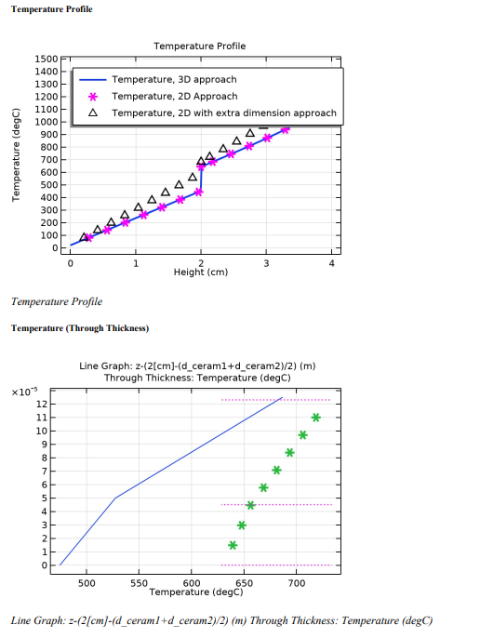
Results Line graphs

Slide 13
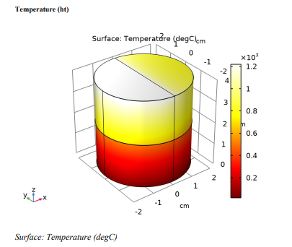
Performance of pure ZrO₂
Thermal Conductivity in W/(m-k) | 1.5
Density in Kg/m3 | 4230
Hot temperature in DegC | 1445.775
temperature thermal barrier in(Deg C) | 530.5

Slide 14
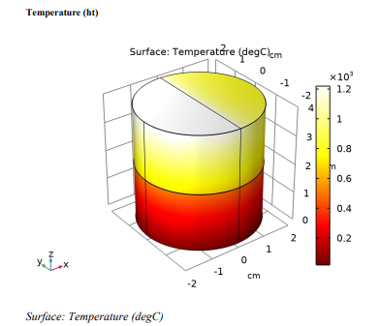
Performance of 7-8YSZ
Thermal Conductivity in W/(m-k) | 1.5
Density in Kg/m3 | 4230
Hot temperature in DegC | 1445.775
temperature thermal barrier in(Deg C) | 530.5

Slide 15
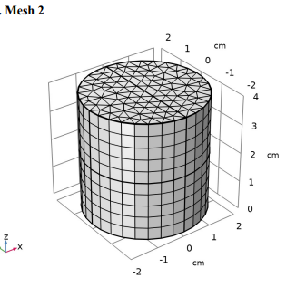
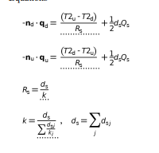
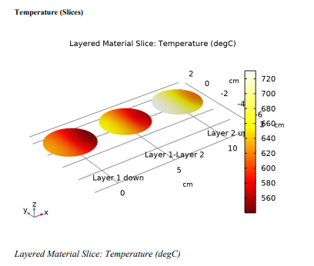
COMPUTATION METHOD OF TWO COMPONENTS BY THERMAL ANALYSIS

Slide 16
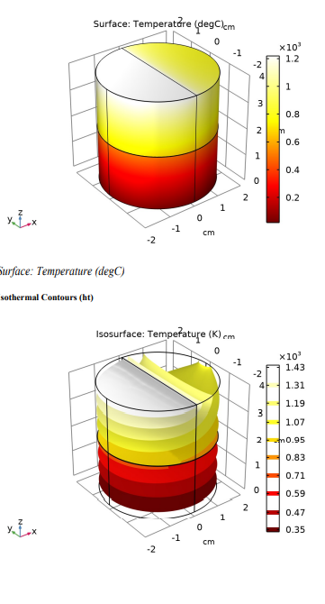
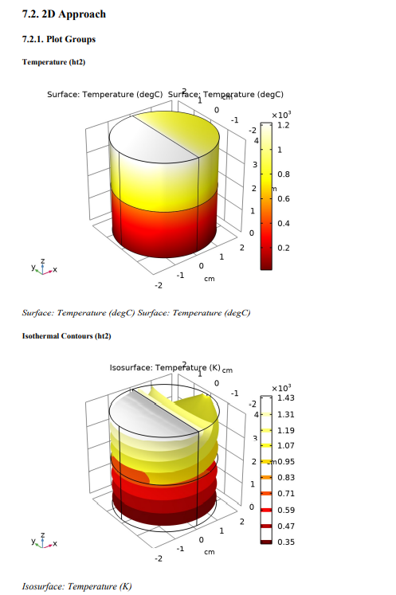
RESULTS AND DISCUSSIONS
We have seen more heat dissipation and more barrier temperature in Pure ZrO₂ and
7-8 YSZ .
By meshing and swept of finite element analysis according to the analysis
two composites are have better performance comparatively.
The pure ZrO₂ ,7-8 YSZ variants proved better by barrier temperatures.

Slide 17
CONCULSION
At last we have conclude that better barrier temperature is obtained in Pure ZrO₂ and 7-8 YSZ .
Though other TBC’s have similar performance but Pure ZrO₂ and 7-8 YSZ having miniature difference in temperatures.
These two TBC’s can further may undergo experimentally in future.

Slide 18
COMPUTATIONAL ANALYSIS OF VARIOUS THERMAL BARRIER COATINGS ON STEEL SURFACE
References:
[1] Giannozzi, Paolo, Stefano Baroni, Nicola Bonini, Matteo Calandra, Roberto Car, Carlo Cavazzoni, Davide Ceresoli et al. "QUANTUM ESPRESSO: a modular and open-source software project for quantum simulations of materials." Journal of physics: Condensed matter 21, no. 39,p.p.395502, 2009.
[2] Vanderbilt, David. "Soft self-consistent pseudopotentials in a generalized eigenvalue formalism." Physical Review B 41, no. 11,p.p. 7892, 1990.
[3] Perdew, John P., Kieron Burke, and Matthias Ernzerhof. "Generalized gradient approximation made simple." Physical review letters 77, no. 18, p.p. 3865,1996.
[4] Da Silva, Juarez LF, M. Veronica Ganduglia-Pirovano, Joachim Sauer, Veronika Bayer, and Georg Kresse. "Hybrid functionals applied to rare-earth oxides: The example of ceria." Physical Review B 75, no. 4, p.p. 045121, 2007.
[5] G. Kresse, "Ab-Initio Molecular-Dynamics for Liquid-Metals," Journal of NonCrystalline Solids, vol. 193, pp. 222-229, Dec 1995.

Slide 19
COMPUTATIONAL ANALYSIS OF VARIOUS THERMAL BARRIER COATINGS ON STEEL SURFACE
[6] P. F. Manicone, P. Rossi Iommetti, and L. Raffaelli, "An overview of zirconia ceramics: basic properties and clinical applications," Journal of Dentistry, vol. 35, pp. 819-26, 2007.
[7] D. Vanderbilt, "Soft self-consistent pseudopotentials in a generalized eigenvalue formalism," Physical review. B, Condensed matter, vol. 41, pp. 7892-7895, 1990.
[8] A. Togo, F. Oba, and I. Tanaka, "First-principles calculations of the ferroelastic transition between rutiletype and CaCl2-type SiO2 at high pressures," Physial Review B, vol. 78, p. 134106, 2008. 40
[9] Naray-Szabo, S., Zeitschrift fuer Kristallographie, Kristallgeometrie, Kristallphysik, Kristallchemie (-144,1977), 94, 414, (1936).
[10] Faucher, M., Golden Book of Phase Transitions, Wroclaw, 1, 1, (2002).
[11] Dachille, F. Simons, P.Y., Acta Crystallographica (1,1948-23,1967), 23, 334, (1967)

Slide 20
COMPUTATIONAL ANALYSIS OF VARIOUS THERMAL BARRIER COATINGS ON STEEL SURFACE
[12] Rietveld HM (1967) Line profiles of neutron powder-diffraction peaks for structure refinement. Acta Crystallogr 22(1):151-152.
[13] Williamson GK, Hall WH (1953) X-ray line broadening from filed aluminium and wolfram. Acta Metall Mater 1(1): 22-31.
[14] Momma K, Izumi F (2011) VESTA 3 for three-dimensional visualization of crystal, volumetric and morphology data. J Appl Crystallogr 44(6):1272-1276.

Slide 21
THANK YOU
SIR

